Slide 1
Summary Measures and Detecting Outliers
Business Analytics
Notes:
Hello again, everyone. Today, we will be discussing circular supply chains.

Slide 2
Summary Measures
After cleaning and organizing data, we need to describe our data:
Measurement of central location
Measurement of dispersion

Slide 3
Measures of Central Location
When we want to describe a characteristic of a population using a single value, we use measurement of central location.
Measurement of central location attempt to find a typical or central value that describes a variable.
Measures of central location:
Mean: sum of the observation over the number of observations
Median: The middle value of a data set
E.g.: [1, 4, 5, 6, 9, 12, 15]

Slide 4
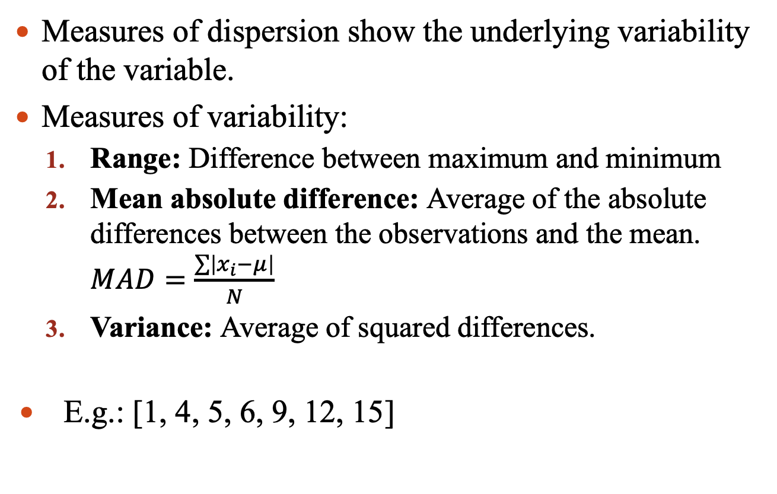
Measures of Dispersion
Measures of dispersion show the underlying variability of the variable.
Measures of variability:
Range: Difference between maximum and minimum
Mean absolute difference: Average of the absolute differences between the observations and the mean. $MAD=\frac{\sum{\left|x_{i}−μ\right|}}{N}$
Variance: Average of squared differences.
E.g.: [1, 4, 5, 6, 9, 12, 15]

Slide 5
Measures of Dispersion
Variance is very sensitive to outliers:
 | Normal data | With oulier
 | 10 | 10
 | 12 | 12
 | 11 | 11
 | 13 | 13
 | 12 | 12
 | 11 | 11
 | 14 | 14
 | 10 | 10
 | 12 | 12
 |  | 40
MAD | 1 | 5.1
Variance | 1.75 | 81.8

Slide 6
Measures of Central Location
Example 3.1: A financial advisor meets an investor who has questions regarding two approaches to mutual fund investing: growth investing versus value investing. Growth funds invest in companies whose stock prices are expected to grow at a faster rate. Value funds, on the other hand, invest in companies whose stock prices are below their true value.
Calculate the mean, median, standard deviation, range, and MAD for different investment options.

Slide 7
Measures of Central Location
Example 3.2: The data file, “Rent”, shows the monthly rent (Rent) and square footage (Footage) for 40 rentals in large college town.
Calculate the mean, range, MAD, and standard deviation for monthly rent.

Slide 8
Detecting Outliers
Extremely large or small observations for a variable are referred to as outliers.
Outliers can influence summary statistics, such as the mean or standard deviation.
Sometimes outliers may just be due to random variations, in which case the relevant observations should remain in the data set.
Outliers may indicate bad data due to incorrectly recorded observations or incorrectly included observations in data set (we need to correct or delete outliers)

Slide 9
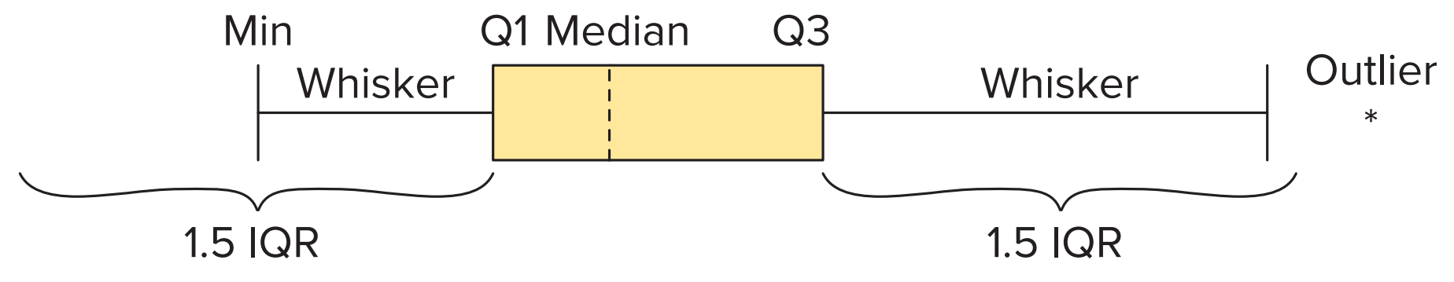
Detecting Outliers
There are no universally agree upon methods for treating outliers.
Box plots:
A common way to quickly summarize a variable is to use a five-number summary.
A five-number summary shows the minimum, the quartiles (Q1, Q2, and Q3), and the maximum.
A boxplot, also referred to as a box-and-whisker plot, is a way to graphically display a five-number summary.
Interquartile range (IQR) = Q3 – Q1

Slide 10
Detecting Outliers
There are no universally agree upon methods for treating outliers.
Box plots:
A common way to quickly summarize a variable is to use a five-number summary.
A five-number summary shows the minimum, the quartiles (Q1, Q2, and Q3), and the maximum.
A boxplot, also referred to as a box-and-whisker plot, is a way to graphically display a five-number summary.
Interquartile range (IQR) = Q3 – Q1
Maximum of{Min, Q1 – 1.5IQR}
Minimum of{Max, Q3 + 1.5IQR}

Slide 11
Detecting Outliers
Example 3.3: Construct a boxplots for the Growth and Value variables from Example 3.1.

Slide 12
Detecting Outliers
Example 3.4: The data file “Prime” shows the annual expenditures (Expenditures) for 100 Amazon Prime customers.
Construct a boxplot for the Expenditures variable. Does the boxplot suggest that outliers exist?
Find the outliers and drop them.

Slide 13
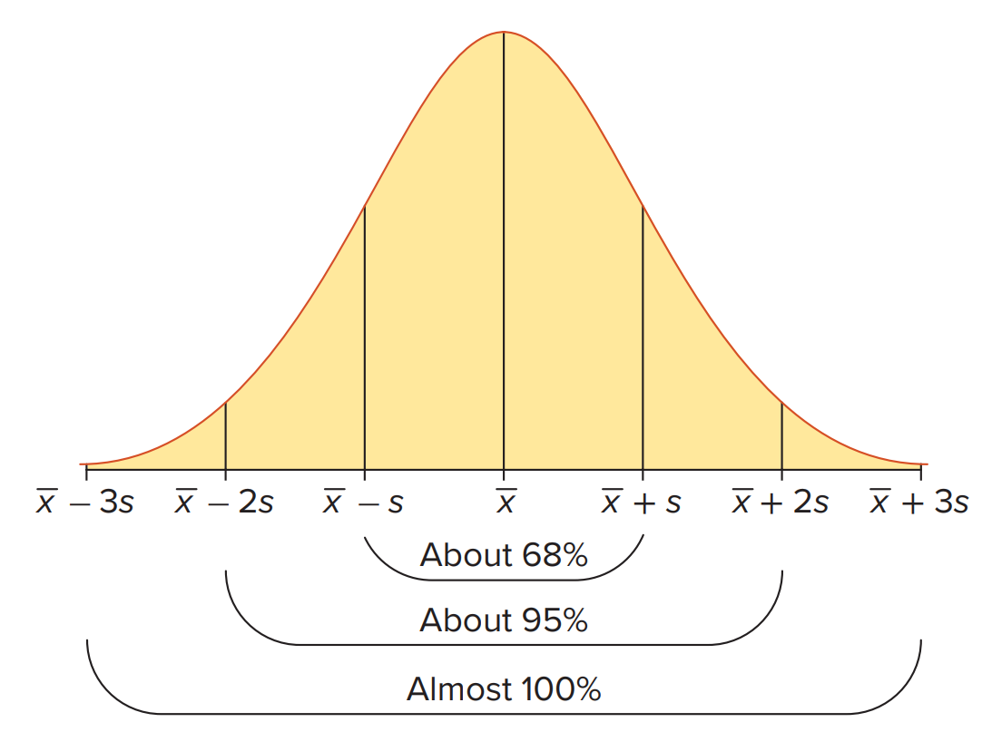
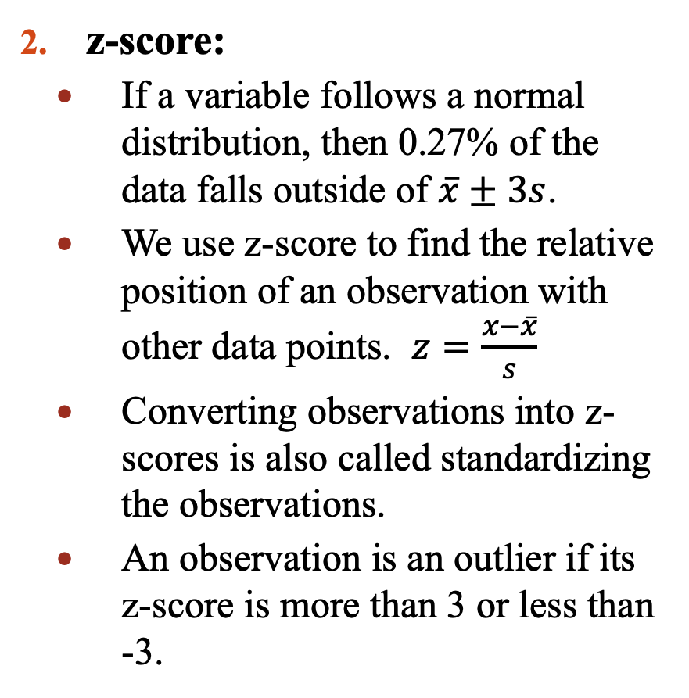
Detecting Outliers
z-score:
If a variable follows a normal distribution, then 0.27% of the data falls outside of $\overline{x}±3s$.
We use z-score to find the relative position of an observation with other data points. $z=\frac{x−\overline{x}}{s}$
Converting observations into z-scores is also called standardizing the observations.
An observation is an outlier if its z-score is more than 3 or less than -3.

Slide 14
Detecting Outliers
Example 3.5: Find the outliers in Example 3.1 for the Growth and Value variables using z-score.

Slide 15
Detecting Outliers
Example 3.6: Find the outliers in Example 3.4 for the Expenditures variable using z-score.

